Slide 1
Design and Implementation of a
Real-Time Multi-User Web Chat System
Using WebSockets
Open Chat Application· RTRP Review II · 2025–26
Batch 15
K. Vishnu Teja (247R1A0595) · P. Harshith (247R1A05B0) · P. Gnyaneshwar (247R1A05B2)
Guide: Dr. V. Naresh Kumar, Associate Professor
open-chat-application-ubti.onrender.com · github.com/Harshith1702/Open_Chat_Application
01

Slide 2
Introduction & Abstract
02
What is Open Chat?
Rooms
Open Chat is a lightweight real-time communication system that enables multiple users to create or join chat rooms and exchange messages instantly using WebSocket-based communication.
The system demonstrates an event-driven architecture for real-time messaging using Node.js, Express, and Socket.IO.
Users create or join chat rooms.
Rooms may be public or password-protected.
Inactive rooms are automatically removed.
Live Features
Real-time messaging
Typing indicators
Live user count
Join / leave notifications
Built with
Node.js – server runtime
Express.js – web framework
Socket.IO – real-time messaging
Render – cloud deployment
No Database
Room and user data stored in memory.
No database dependency.
Lightweight and simple architecture.

Slide 3
Existing Systems
03
Slack – enterprise collaboration tool
Discord – community communication platform
Microsoft Teams – corporate messaging system
Rocket.Chat – open-source chat platform
Mattermost – self-hosted team messaging
Telegram Web – browser-based messaging
WhatsApp Web – real-time messaging platform

Slide 4
Disadvantages of Existing Systems
04
Needs an account
Heavy infrastructure
Complex setup
Most platforms require user registration and authentication before allowing users to communicate.
These systems rely on complex backend infrastructure including databases, authentication services, and cloud configurations.
Deploying platforms like Rocket.Chat or Mattermost requires advanced server setup and DevOps knowledge.
Not for learning
No auto room cleanup
No anonymous access
Many existing chat platforms have large and complex codebases that are difficult for beginners to understand.
Chat rooms often remain active even when no users are present, which wastes server resources.
Anonymous access is usually not supported, making quick link-based communication difficult.

Slide 5
Proposed System — Open Chat
05
Create / Join Rooms
Event Flow
Users can create or join chat rooms.
Rooms may be public or password protected.
Browser
↓
Real-time messaging
Socket.IO Client
Messages appear instantly via WebSocket — no refresh, no delay.
↓
Express Server
Typing indicators
↓
See when someone's typing with a live indicator.
Room Manager
Auto room cleanup
Room disappears the moment the owner disconnects.
Tech Stack
Password-protected rooms
Node.js · Express · Socket.IO · Render
Add a password for private conversations.

Slide 6
Advantages of Proposed System
06
No user registration required
Real-time WebSocket communication
Lightweight architecture (no database)
Automatic room lifecycle management
Password-protected private rooms
Accessible from any device with a web browser
Cloud deployment on Render via GitHub
Simple and maintainable codebase

Slide 7
Requirements
07
HARDWARE
SOFTWARE
Development System
• Processor: Intel i3 or equivalent
• RAM: Minimum 4 GB
• Storage: 500 MB free space
• Network: Stable internet connection
Client Devices
• Laptop / Desktop / Tablet / Smartphone
• Any modern web browser with WebSocket support
Runtime
Node.js v18+
Framework
Express.js
WebSocket
Socket.IO v4
Browser
Chrome / Firefox / Edge
Hosting
Render Cloud Platform
Version Control
GitHub

Slide 8
Project Novelty
08
1
Database-free architecture
Room and user state are maintained in server memory using in-memory data structures instead of a database.
2
Automatic room lifecycle
Chat rooms are automatically deleted when the last connected user leaves the room.
3
Real-time event architecture
Messages are delivered instantly through WebSocket-based event-driven communication.
4
Cloud Deployment
The application is deployed on Render and automatically updated through GitHub integration.

Slide 9
System Architecture
09
CLIENT
SERVER
DEPLOYMENT
· Browser (HTML / CSS / JS)
· Node.js + Express (HTTP)
· Render Cloud Platform
⟷
· Socket.IO Client Library
· Socket.IO Server (WS)
· GitHub CI/CD
⟷
· Responsive browser interface
· HTTPS + WSS
· Room & User Manager (In-memory Map)
· Event Handler

Slide 10
Modules
10
M1 User Management
Handles socket registration and username management.
Tracks active users and broadcasts join/leave events.
M2 Room Management
Creates and manages chat rooms.
Validates passwords, enforces limits, and removes empty rooms.
M3 Messaging
Handles sending and receiving messages using Socket.IO.
Broadcasts messages to all users within a room.
M4 Typing Indicator
Detects typing events from users.
Displays real-time typing indicators in the chat room.
M5 Frontend UI
Responsive browser interface built with HTML, CSS, and JavaScript.
Updates chat messages dynamically without page reloads.
Application deployed on Render cloud platform.
Automatic deployment triggered via GitHub integration.
M6 Deployment

Slide 11
UML – Use Case Diagram
11
«system» Open Chat Application
Create Room
Set Password
Enter Username
View Online Users
User
Join Room
See Typing Indicator
Send Message
Leave Room

Slide 12
UML – Class Diagram
12
«class»
1
*
«class»
1
*
«class»
ChatServer
▶
Room
▶
User
- port : Number
- roomId : String
- socketId : String
- rooms : Map<String, Room>
- name : String
- username : String
- password : String
- roomId : String
+ listen() : void
- maxUsers : Number
+ handleConnection(socket)
- users : List<User>
+ sendMessage(msg) : void
+ disconnect() : void
+ addUser(u) : void
+ removeUser(id) : void
+ isEmpty() : Boolean
+ isPrivate() : Boolean

Slide 13
UML – Sequence Diagram
13
User
(Browser)
Socket.IO
Client
Express
Server
Room
Manager
connect()
▶
joinRoom(name, pass)
▶
emit('join-room')
▶
validateRoom()
▶
success / error
◀
emit('user-joined')
◀
updateUI(users)
◀
sendMessage(text)
▶
emit('message')
▶
broadcast to room
◀

Slide 14
UML – Activity Diagram
14
Open Website
▼
[Create]
Create or Join?
[Join]
Create Room
(name, public/private)
Join Room
(enter password if private)
▼
Enter username
▼
Chat — send messages, typing, user count
▼
Disconnect → auto cleanup if last user
▼

Slide 15
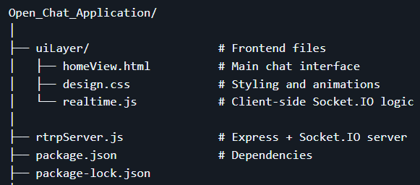
File Structure
15

Slide 16
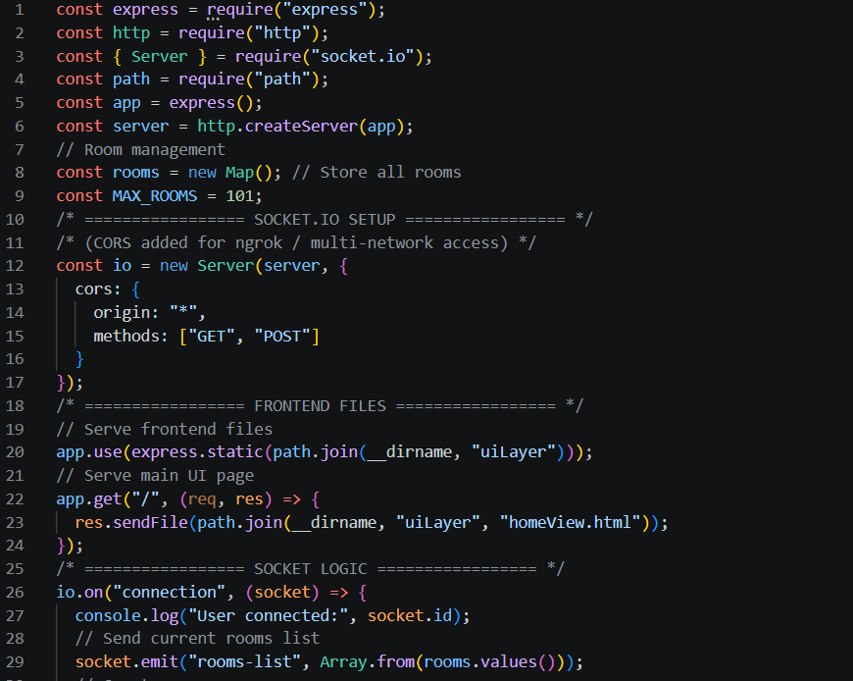
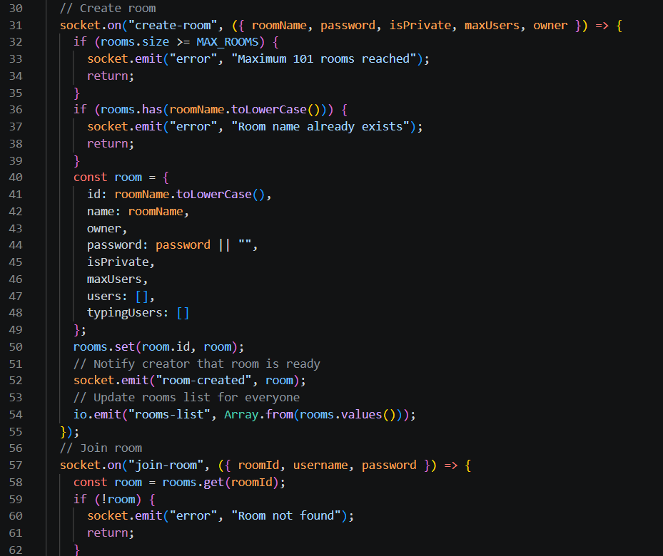
Source Code
16
rtrpServer.js -

Slide 17
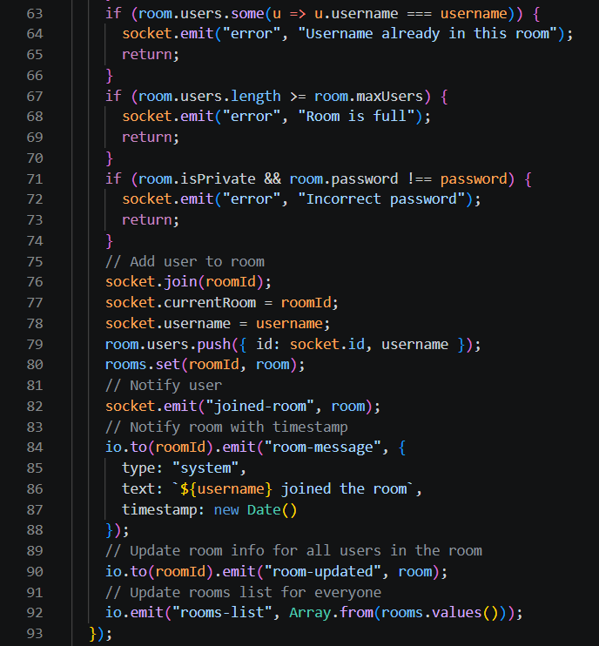
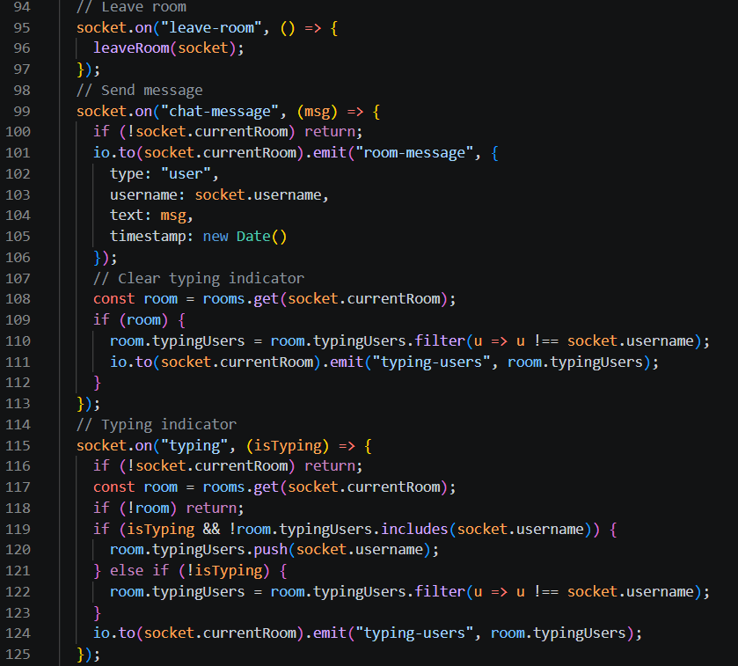
17

Slide 18
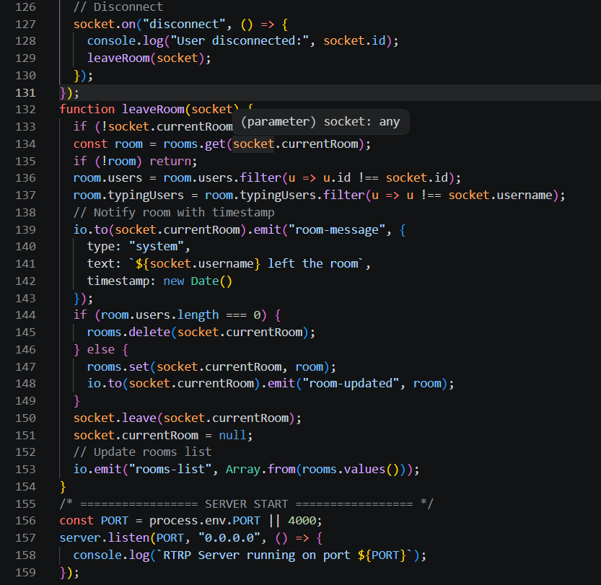
18

Slide 19
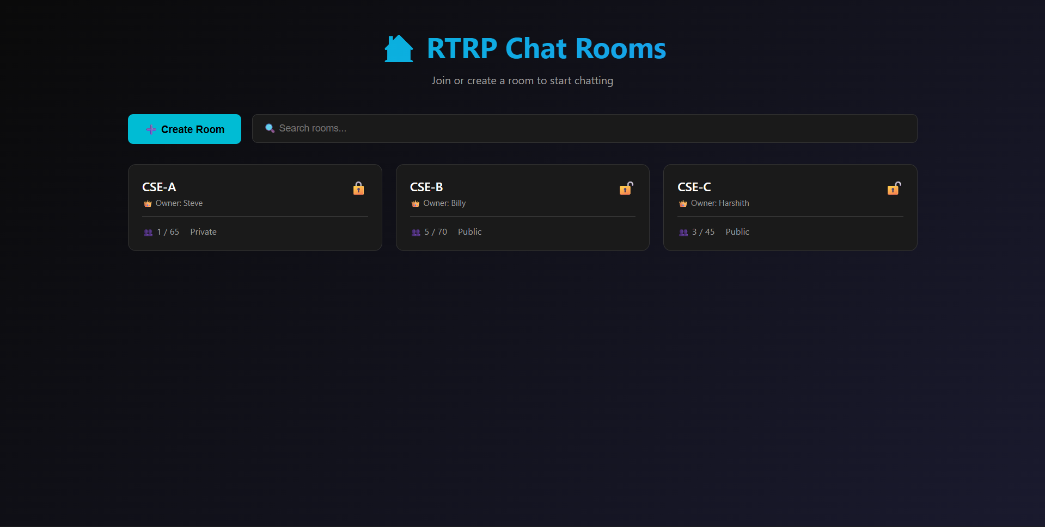
Results
19
Desktop-view

Slide 20
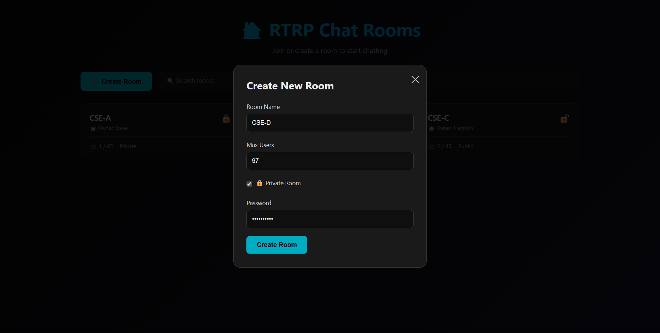
20
Create-room

Slide 21
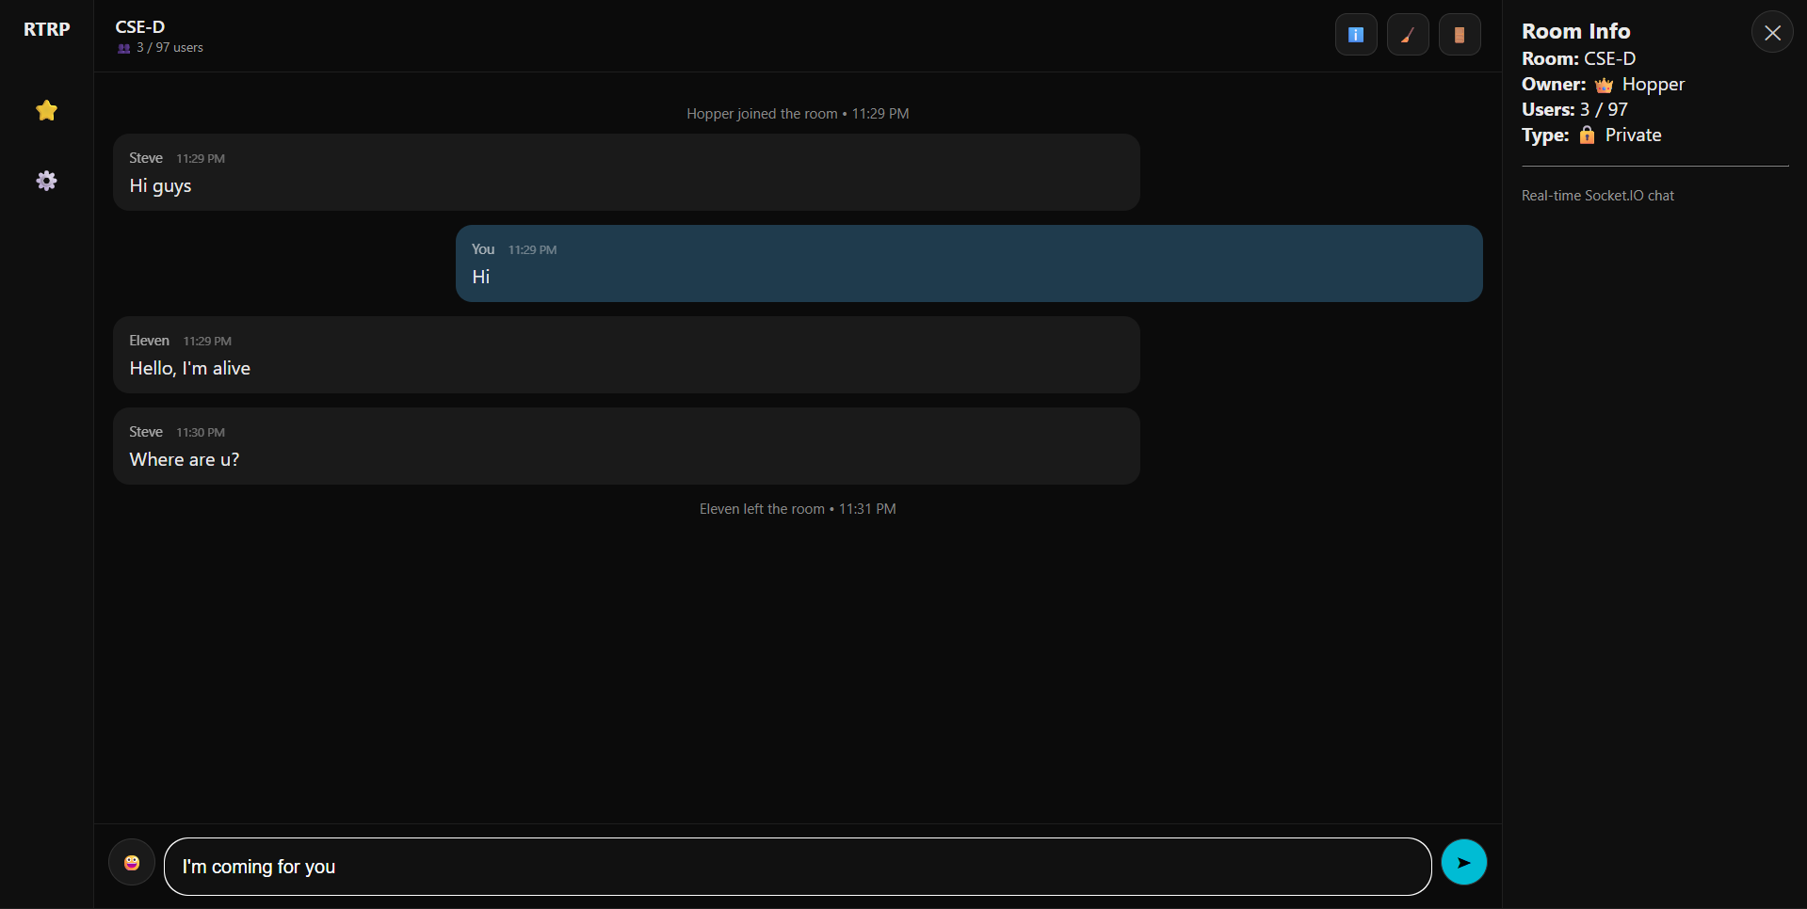
Chat-room
21

Slide 22
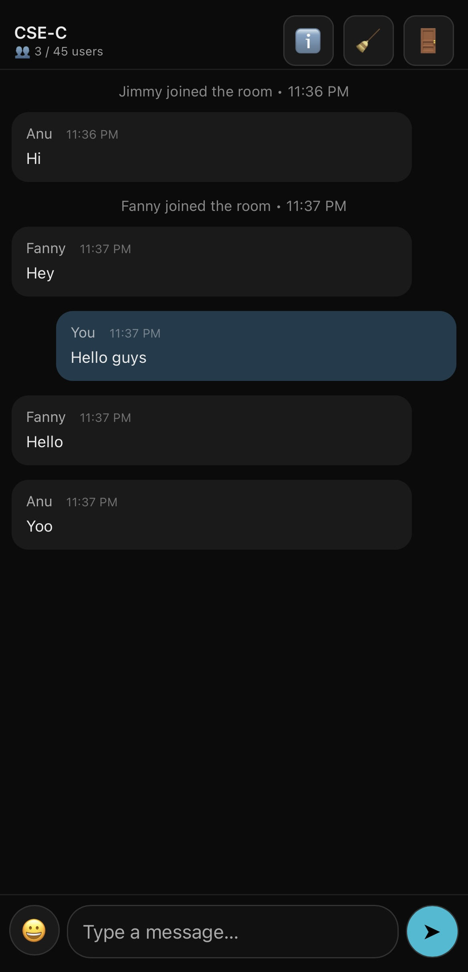
22
Mobile-view

Slide 23
Future Enhancements
23
1.Message Reactions & Emojis - Add emoji reactions per message, broadcasted to all users in the room.
File & Image Sharing - Support small files via Base64 encoding, larger assets via HTTP upload.
Room Moderation Tools - Allow owners to set message rate limits, or transfer ownership.
4.Horizontal Scalability - Use Socket.IO Redis Adapter to synchronize events across multiple servers.

Slide 24
Conclusion
24
Designed and implemented a real-time multi-user chat system using WebSocket-based communication.
Users can create or join chat rooms and exchange messages instantly through an event-driven architecture.
The system uses a lightweight backend with in-memory room management and no database dependency.
The application is successfully deployed on Render and accessible from any modern web browser.

Slide 25
References
25
RFC 6455 – WebSocket Protocol Defines full-duplex, persistent communication between browser and server.
Socket.IO Framework (LearnBoost, 2010) Event-driven library adding reliability, rooms, and reconnection features.
3.Existing Platforms (Slack, Discord, Rocket.Chat, Mattermost) Heavy infrastructure, complex setup, not beginner-friendly.
4.Render Cloud Deployment GitHub CI/CD integration with HTTPS for live hosting.

Slide 26
Links
26
GitHub-https://github.com/Harshith1702/Open_Chat_Application
Live (Deployed)- https://open-chat-application-ubti.onrender.com/

